Slide 1
Overcoming Barriers to Implementing Just Culture Deena Linehan 02/23/2025

Slide 2
Introduction
A Just Culture is critical for fostering transparency, learning, and accountability in any organization. However, various barriers make its implementation challenging, ranging from cultural hurdles to ineffective systems.

Slide 3
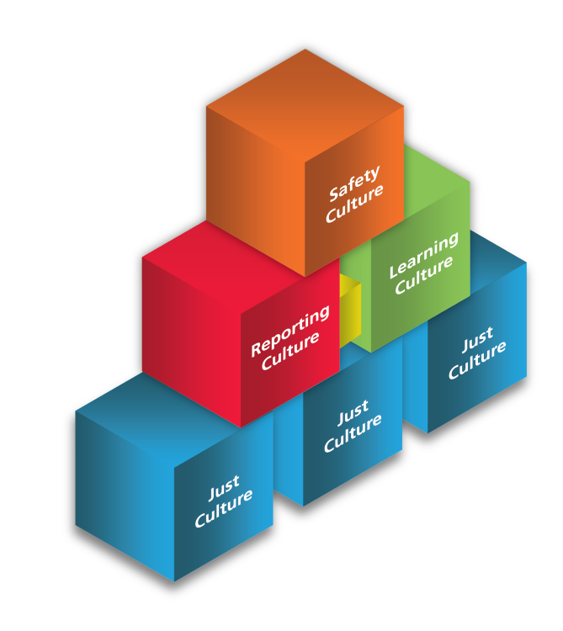

Slide 4

Blame Culture – Barrier 1
People tend to attribute mistakes to personal flaws which results in blame rather than system improvements. Mistaken beliefs about how much control individuals have in situations often leads to punitive actions.
Solution: Avoiding quick judgements and assess errors as opportunities to identify system weaknesses. You can also use human factors knowledge to understand the broader context of actions.

Slide 5

Outcome Bias – Barrier 2
The outcome of a situation often influences decisions about accountability, with more harm leading to harsher responses. This bias undermines a fair and consistent approach to error assessment. Solution: Evaluate actions without considering the outcome. Focus on what individuals could reasonably have done in the same circumstances

Slide 6
Lack of Transparency – Barrier 3
Many organizations fail to communicate how actions will be assessed in the event of an incident. Workers are often unaware of the criteria and processes behind decision-making.
Solution: Make assessment processes and decision making transparent to all stakeholders to ensure clarity and fairness.

Slide 7
Siloed Organizational Structure – Barrier 4
Departmental silos impede collaboration, which is essential for implementing a Just Culture. Lack of communication between teams hinders understanding and accountability.
Solution: Foster cross functional teams and shared goals. Encourage communication and collaboration between departments to break down silos.

Slide 8
Resistance to Change – Barrier 5
Employees fear the impact of change on their roles and responsibilities, especially when new systems disrupt established processes.
Solution: Leaders should communicate the benefits of change and emphasize how it will enhance careers. Highlight that change enhances roles rather than eliminating them.

Slide 9
Inconsistent Assessment Processes – Barrier 6
Inconsistent processes for assessing errors leads to arbitrary or unfair responses
Solution: Implement consistent and systematic approaches to assess actions and determine appropriate responses based on the context of the situation.

Slide 10
Conclusion
Overcoming these barriers is important for establishing a Just Culture that prioritizes learning, accountability, and collaboration. Key strategies include enhancing transparency, promoting collaboration, fostering trust, and implementing consistent processes for assessment. By addressing these challenges, organizations can create a culture that supports growth, innovation, and safety.

Slide 11
Sources
https://hackernoon.com/cultural-challenges-in-devops-adoption-and-how-to-overcome-them
https://justculture.hqca.ca/overcoming-barriers-to-a-just-culture/

